Slide 1

DELHI TECHNOLOGICAL UNIVERSITY
DATA STRUCTURES (DS-201)
PROJECT REPORT
QUIZ GAME
Prepared By:
Divyanshu Singh (2K19/SE/040)
Farhan Raja (2K19/SE/041)
Submitted To:
Prof. Indu Singh

Slide 2
ABSTRACT
This Quiz Game project aims to provide its users with a chance to enhance their general knowledge and mental skills in a fun and exciting way. It is a menu driven game which provides its users the option to play/quit and an option to login as admin to alter questions asked in the game. It consists of 3 levels. Player starts from level 1 and progresses on scoring points accordingly. There is a ‘Bonus Level’ which follows a MCQ format made for the sole purpose of improving player’s score. Overall, it is a great way to practice and polish our concepts of Data Structures.

Slide 3
MODULES
The program has following main modules:
The main class “game” that controls the entire gameplay process.
All the three functions for level 1, 2, 3 of the game including the score keeping structure.
A special function for the ‘Bonus Level’ of the game which takes input from a text file.
Admin section to add or delete bonus questions.

Slide 4
Headers Files Used
Filename | Description
IOSTREAM.H | C++ Standard Library that implements stream-based input/output capabilities.
FSTREAM.H | Provides functions for file handling.
CONIO.H | Helps in basic console I/O functions.
WINDOWS.H | Contains declarations for all of the functions in the Windows API.
STRING.H | Contains functions with string handling capabilities.
STDIO.H | Provides function with standard I/O capabilities.

Slide 5
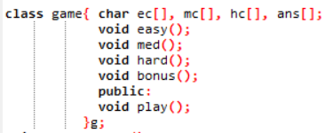
Game Class Declaration
The screenshot for the class ‘game’ which controls the entire gameplay of this game.

Slide 6
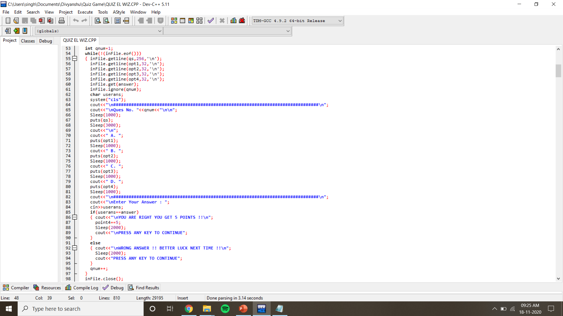
Reading questions from file for Bonus Round and displaying it

Slide 7
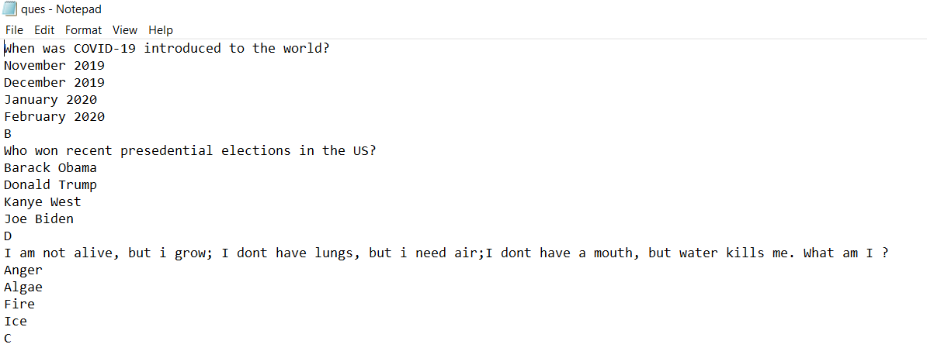
Reading questions from file for Bonus Round and displaying it

Slide 8
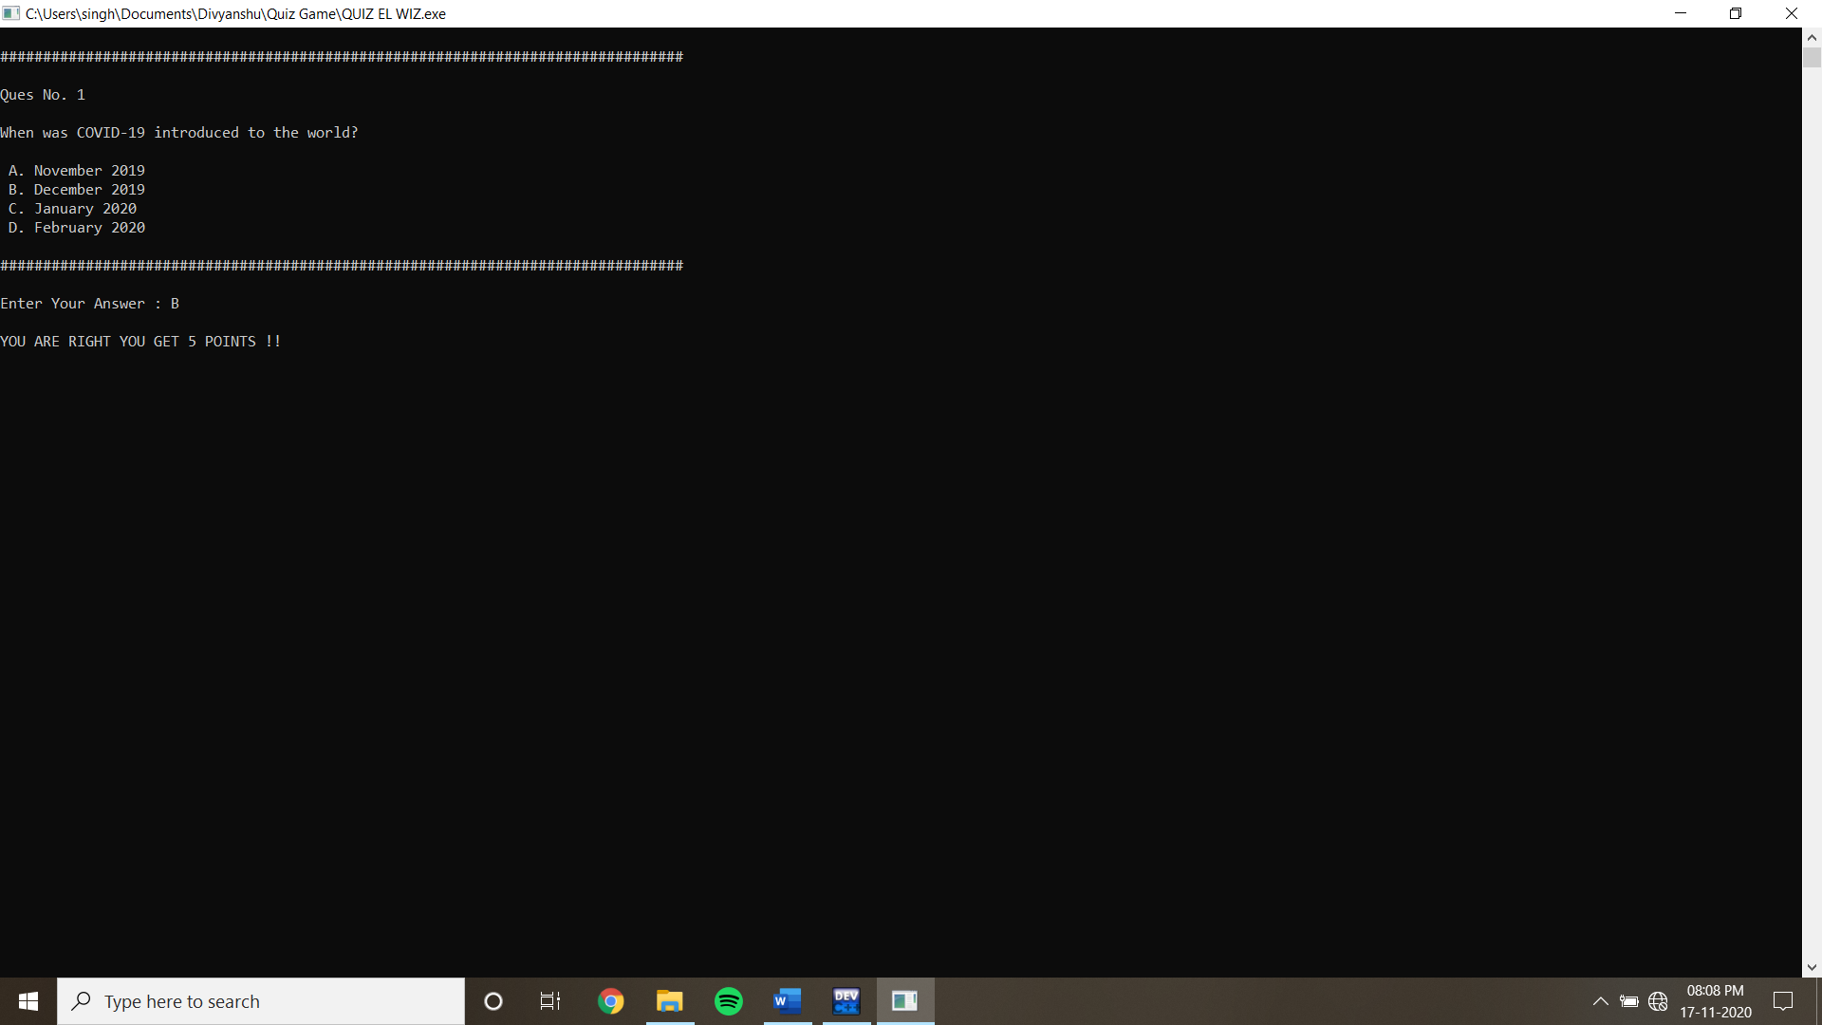
Reading questions from file for Bonus Round and displaying it

Slide 9
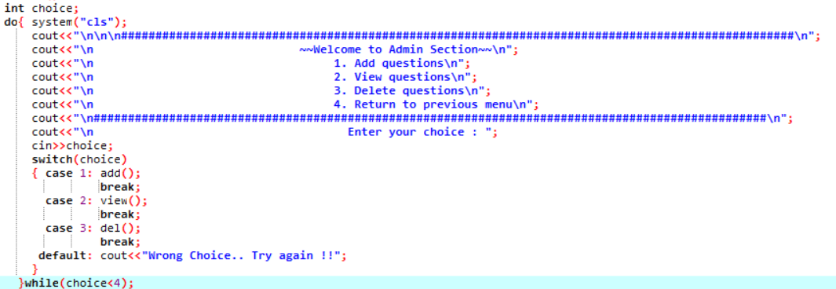
Admin Function

Slide 10
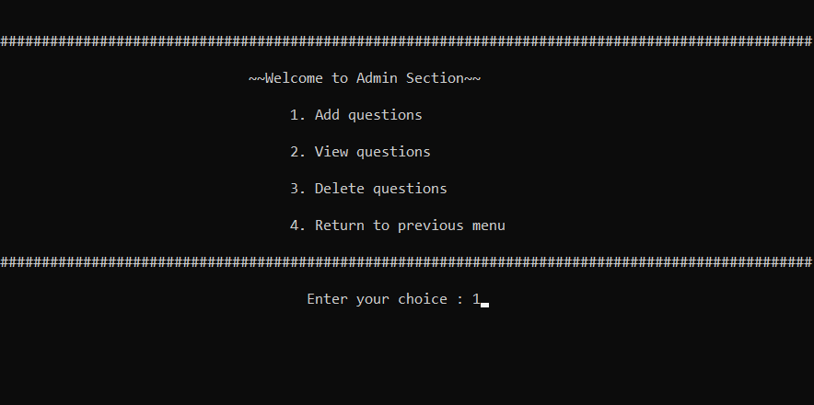
Admin Function

Slide 11
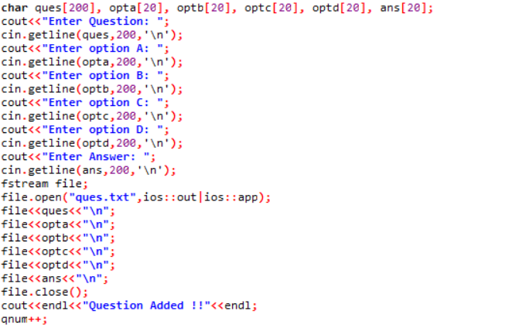
Add Function

Slide 12
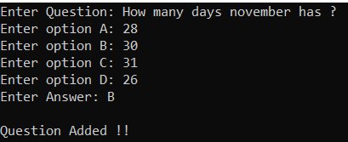

Add Function

Slide 13
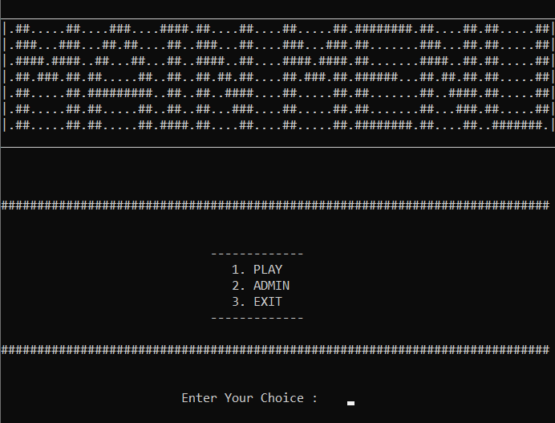
OUTPUTS
(Main Menu)

Slide 14
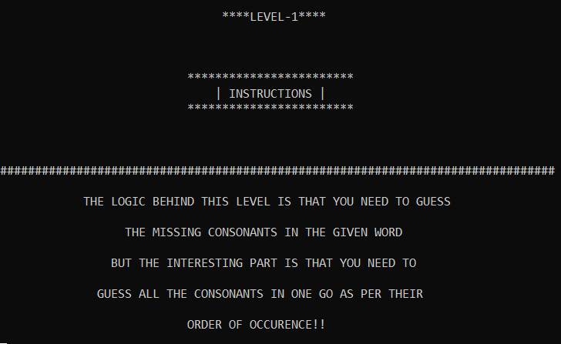
(Instructions to level-1)

Slide 15
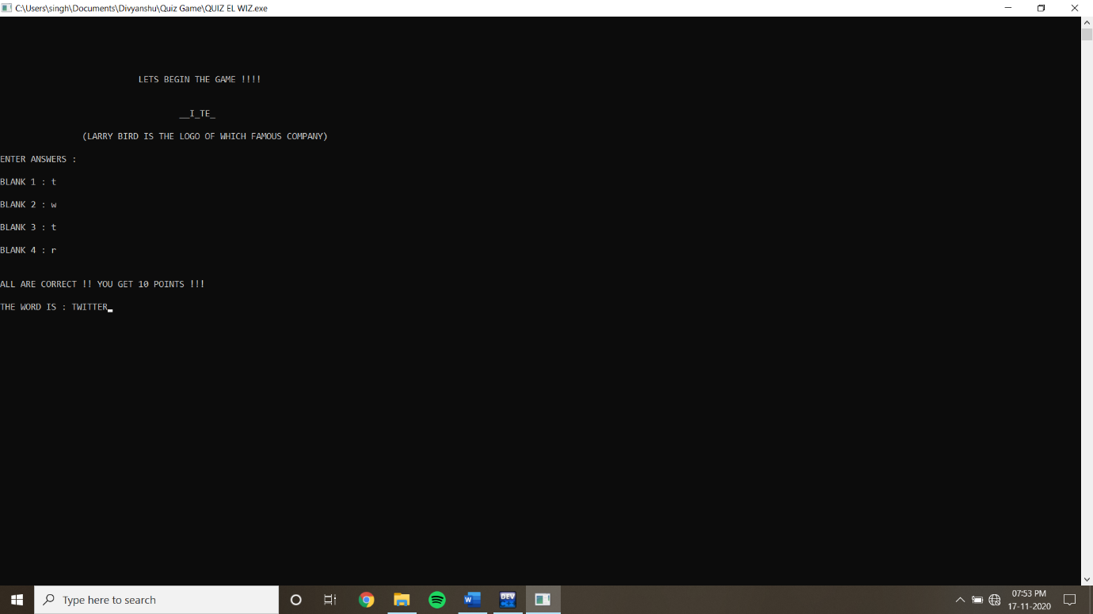
(Entering Answers to level-1 questions)

Slide 16
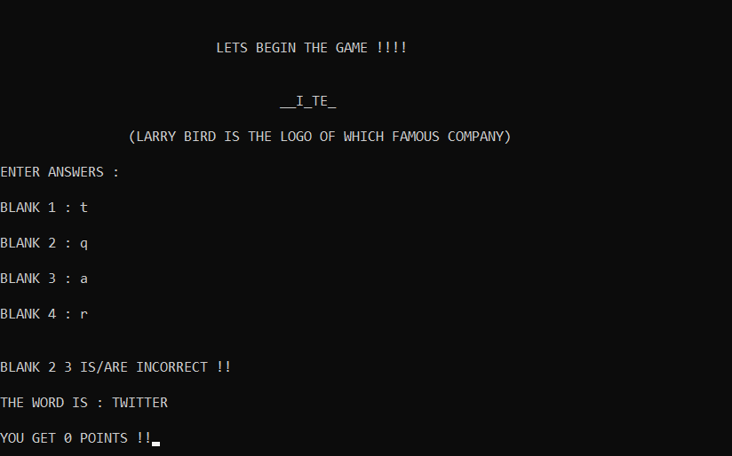
(Entering Answers to level-1 questions)

Slide 17
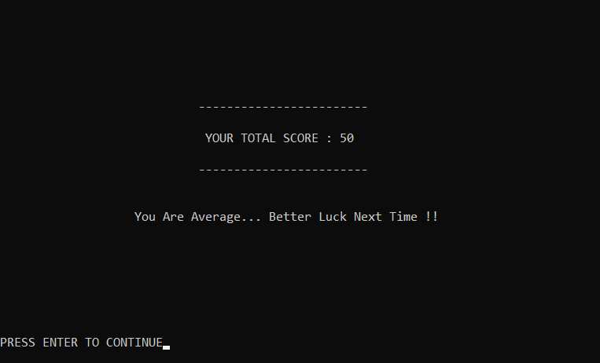
(Displaying total score of the user with a remark)

